Slide 1
Trunica Notepad Application
Raj Desai
David Nwagbuo
Antoninus Lamptey
Department of Computer Science and Engineering
University of South Florida
Tampa, FL 33620

Slide 2
Acknowledgements
Brad Lawrence
CEO of Trunica
Ken Christensen

Slide 3
Background
The goal of our project is to develop a note taking mobile application that made use of geo-location.
Geo-locating is the means of using a phone’s GPS, Wi-Fi or Bluetooth to find out where you are.
The application is to be designed for all 3 mobile platforms (Android, iOS, Windows).
The target audience is anyone with a mobile device.

Slide 4
Problem
Problem Statement: “How can we know what other people have noted at a specific location?”

Slide 5
Requirements
1. To develop a mobile application that will function as a notepad.
2. Each note should have a location attached to it.
3. The application will have a privacy lock where the user decides whether or not to allow other users at a given location to access their notes.
4. The notes saved in the notepad application would be pushed to the cloud, in a given time frame of 1 -2 minutes.
5. Users should be able to access any notes in a given incremental radius of 10 miles (up to about 30 miles).
6. The user should be able to write the note from anywhere and attach any location to it.

Slide 6
Design/Specification
Development environment:
Cordova provides the framework and specialized JavaScript libraries required to create the notepad application.
Languages:
HTML And CSS - Used to develop the user interface.
JavaScript - Used to create the logic, for e.g. geolocation API, sharing to cloud.

Slide 7
Design/Specification
The main problem of this project can be split up into 3 separate modules:
Create a note
Involves choosing what kind of file your note will be, i.e. video, picture, audio, text
Generates the note
Retrieving and attaching a location to that note
This will be achieved using the Cordova geo-location API
Publishing the note to a cloud
The slides will be published using Apache
There should also be an option to keep the note private and visible only to the owner.

Slide 8
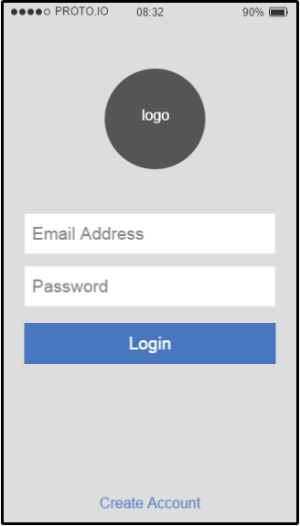
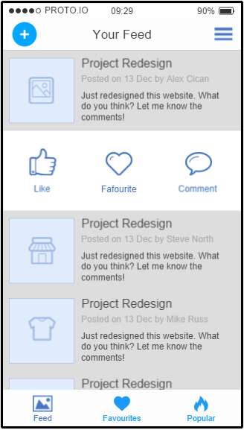
Design/Specification

Slide 9
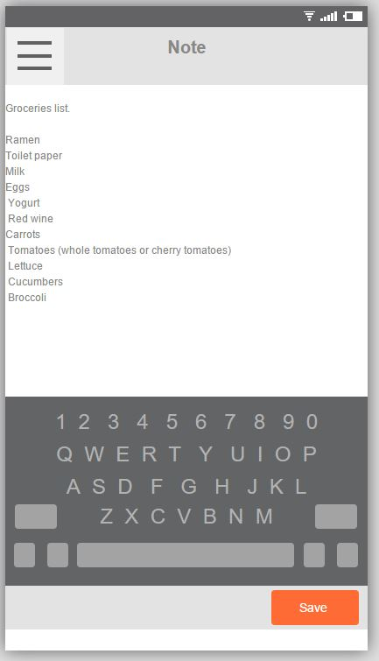
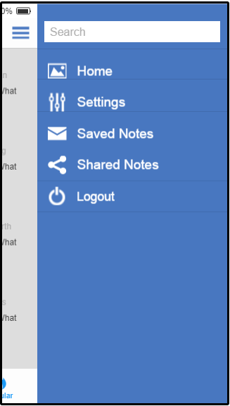
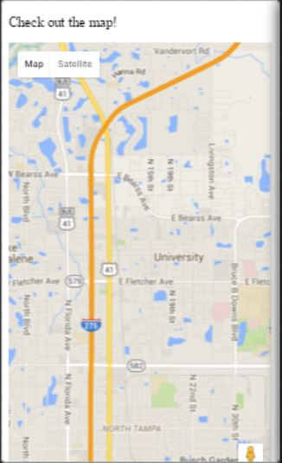
Design/Specification

Slide 10
Analysis
Our app is serves many purpose
Notetaking
Review
Location Targeting
Free to Use
Ease and efficiency:
Cordova allows you to integrate your everyday web technologies(HTML,CSS, JavaScript).
Cordova allows us to create the application for all 3 mobile platforms but only having to write the code once.

Slide 11
Project Plan
2/26/2016
Create a application capable of creating and storing notes
Incorporate geolocation with the notes
Include the ability to publish notes publicly
Have a final prototype
Prototype Demo
Practice project presentation and demonstration
Final Project Presentation/Demonstration
3/4/2016
3/11/2016
3/18/2016
3/25/2016
4/18/2016
5/02/2016

Slide 12
Sources
https://taco.visualstudio.com/en-us/docs/create-to-do-list-app/
https://www.fluidui.com/editor/live/

Slide 13
Questions?

